Slide 1
Stock Prediction with CNN-TA
By: Emmy Veselinov, Jubayer Ahmed, Eric Li
Sezer, Omer & Ozbayoglu, Murat. (2018). Algorithmic Financial Trading with Deep Convolutional Neural Networks: Time Series to Image Conversion Approach.

Slide 2
Table of contents
01
04
02
05
03
06
Introduction
Feature Selection
Data
Training & Evaluation
Feature Engineering
Backtests

Slide 3
1. Introduction

Slide 4
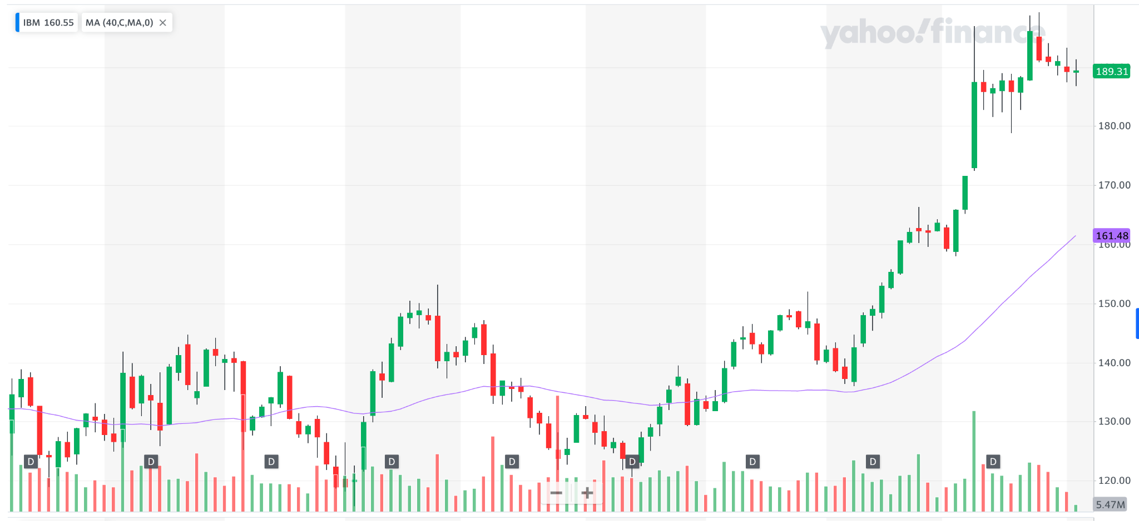
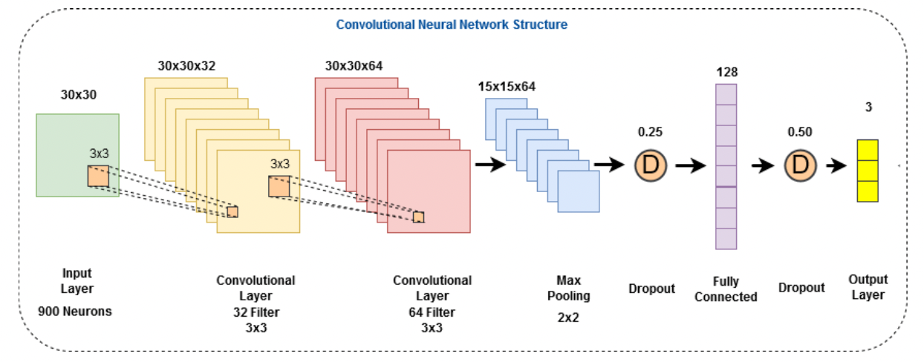
Related Work
CNN-TA
Implements a CNN on 2D images constructed from 1D financial time series.
Creates 15x15 (225 features) images per trading day for training.
Predicts Buy/Sell/Hold classes.
Sezer, Omer & Ozbayoglu, Murat. (2018). Algorithmic Financial Trading with Deep Convolutional Neural Networks: Time Series to Image Conversion Approach.
Notes:
Eric/Jubayer?

Slide 5
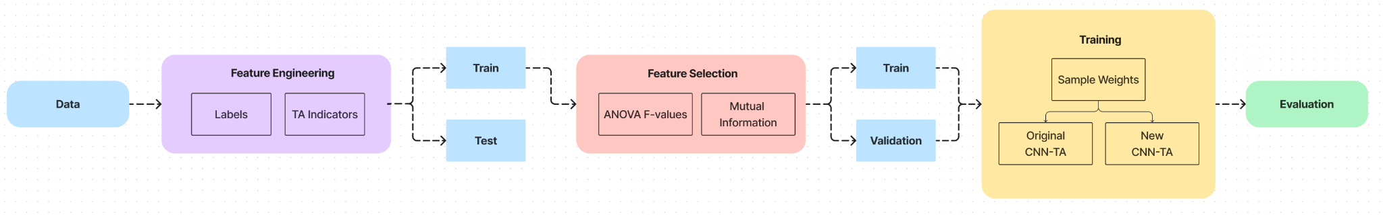
Architecture
Notes:
Eric

Slide 6
2. Data

Slide 7
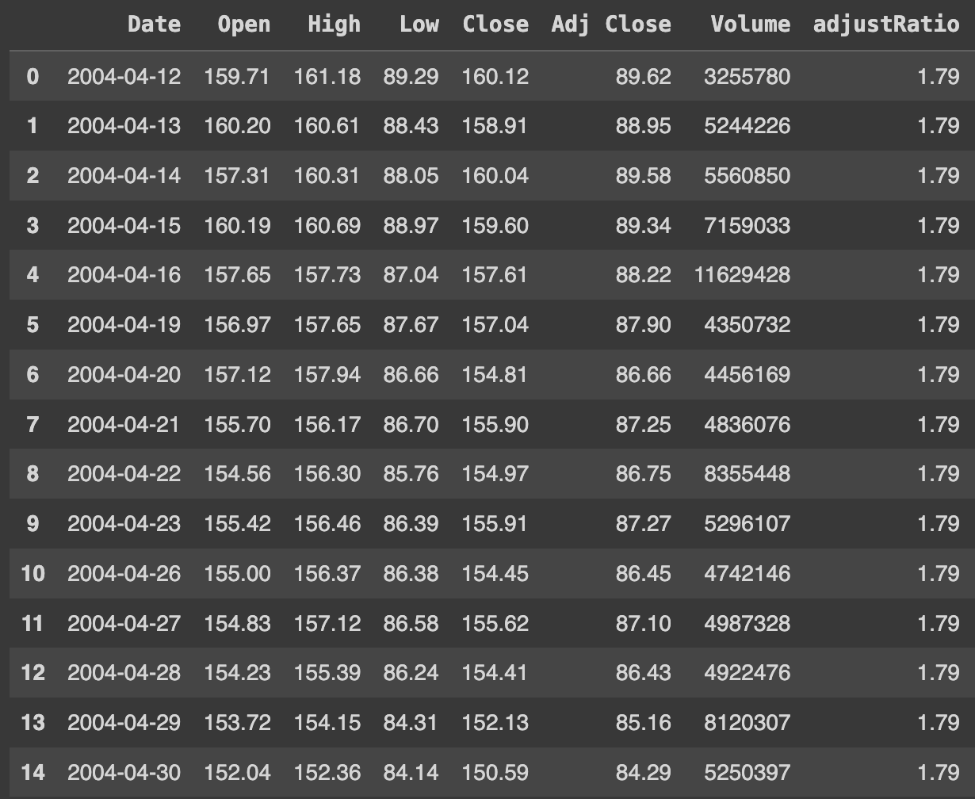
IBM Data
20 years of data from the Yahoo Finance API (2004 - 2024)
8 features:
Date
Open, High, Low, Close, Volume (OHLCV)
Adj. Close, Adj. Ratio
Notes:
Emmy

Slide 8
3. Feature Engineering

Slide 9
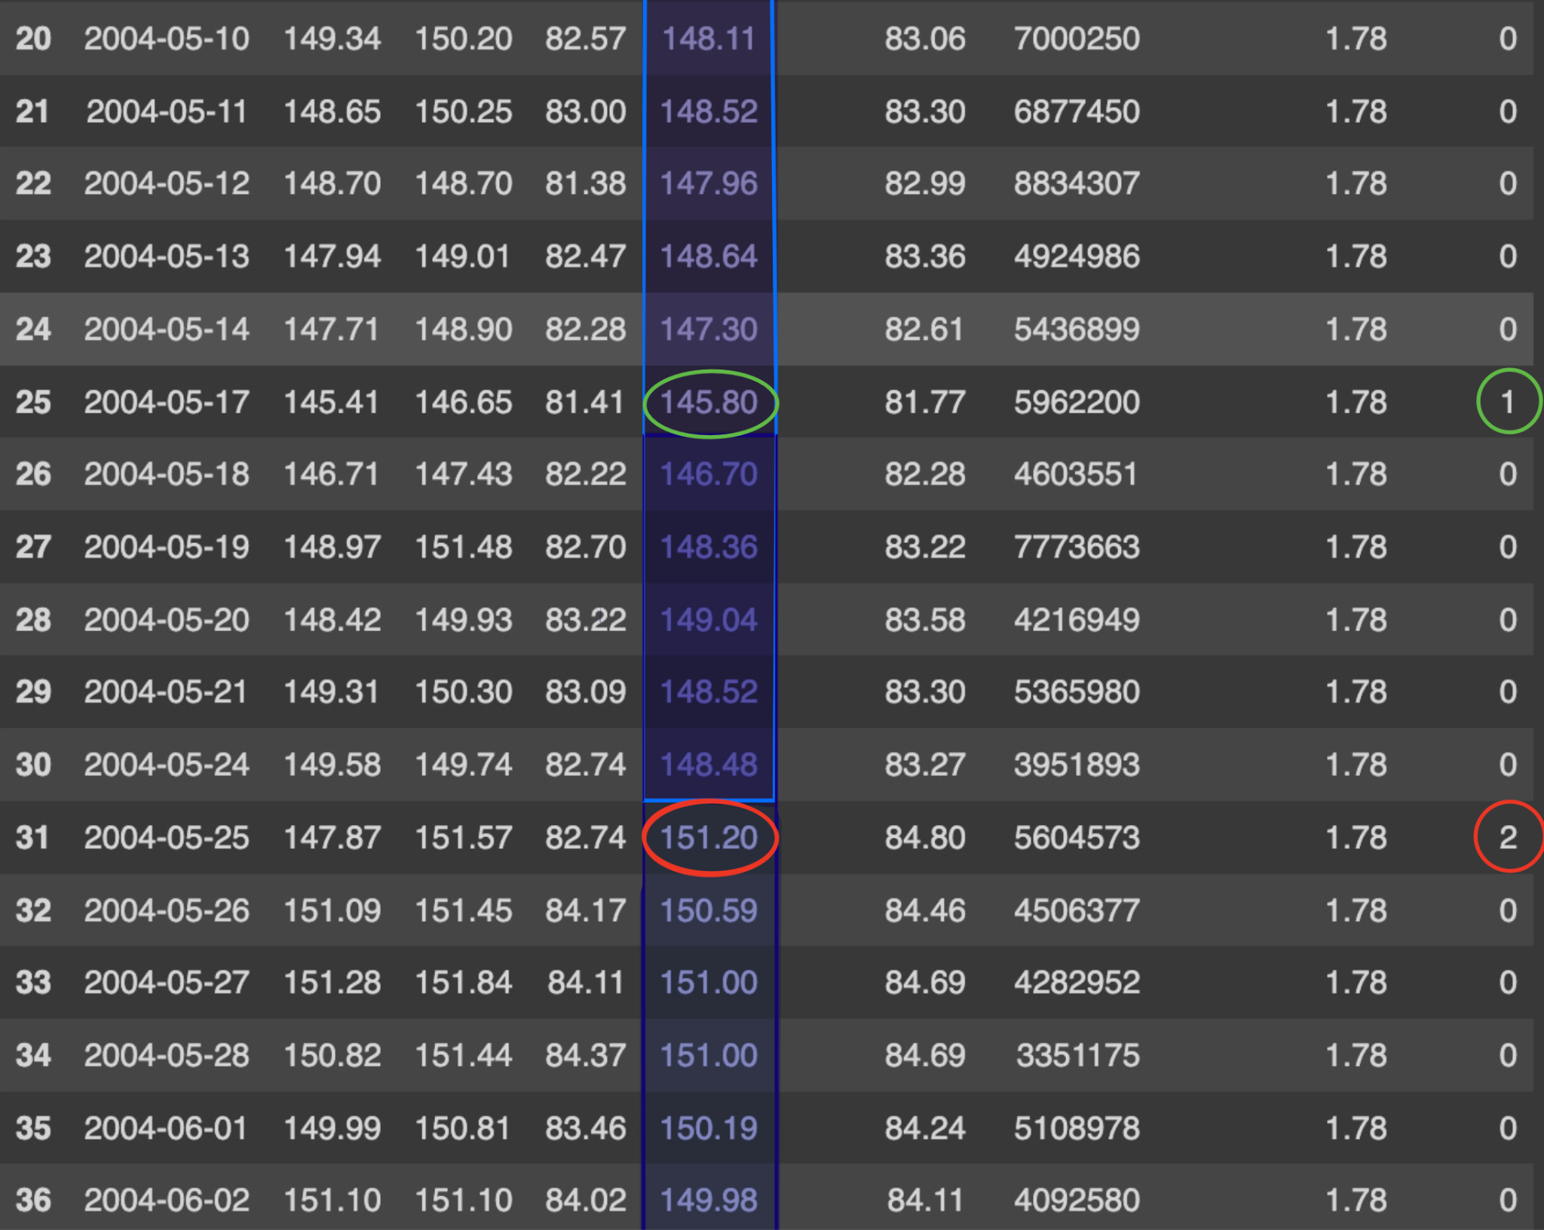
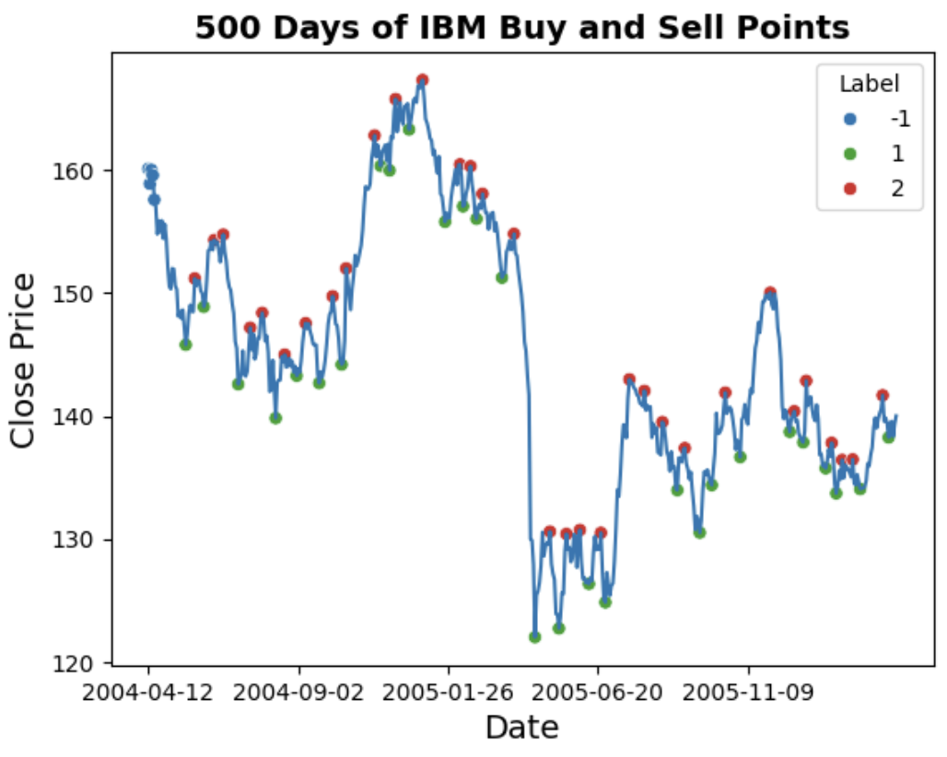
Labeling the Data
Hold: 0
Buy: 1
Sell: 2
Notes:
Emmy

Slide 10
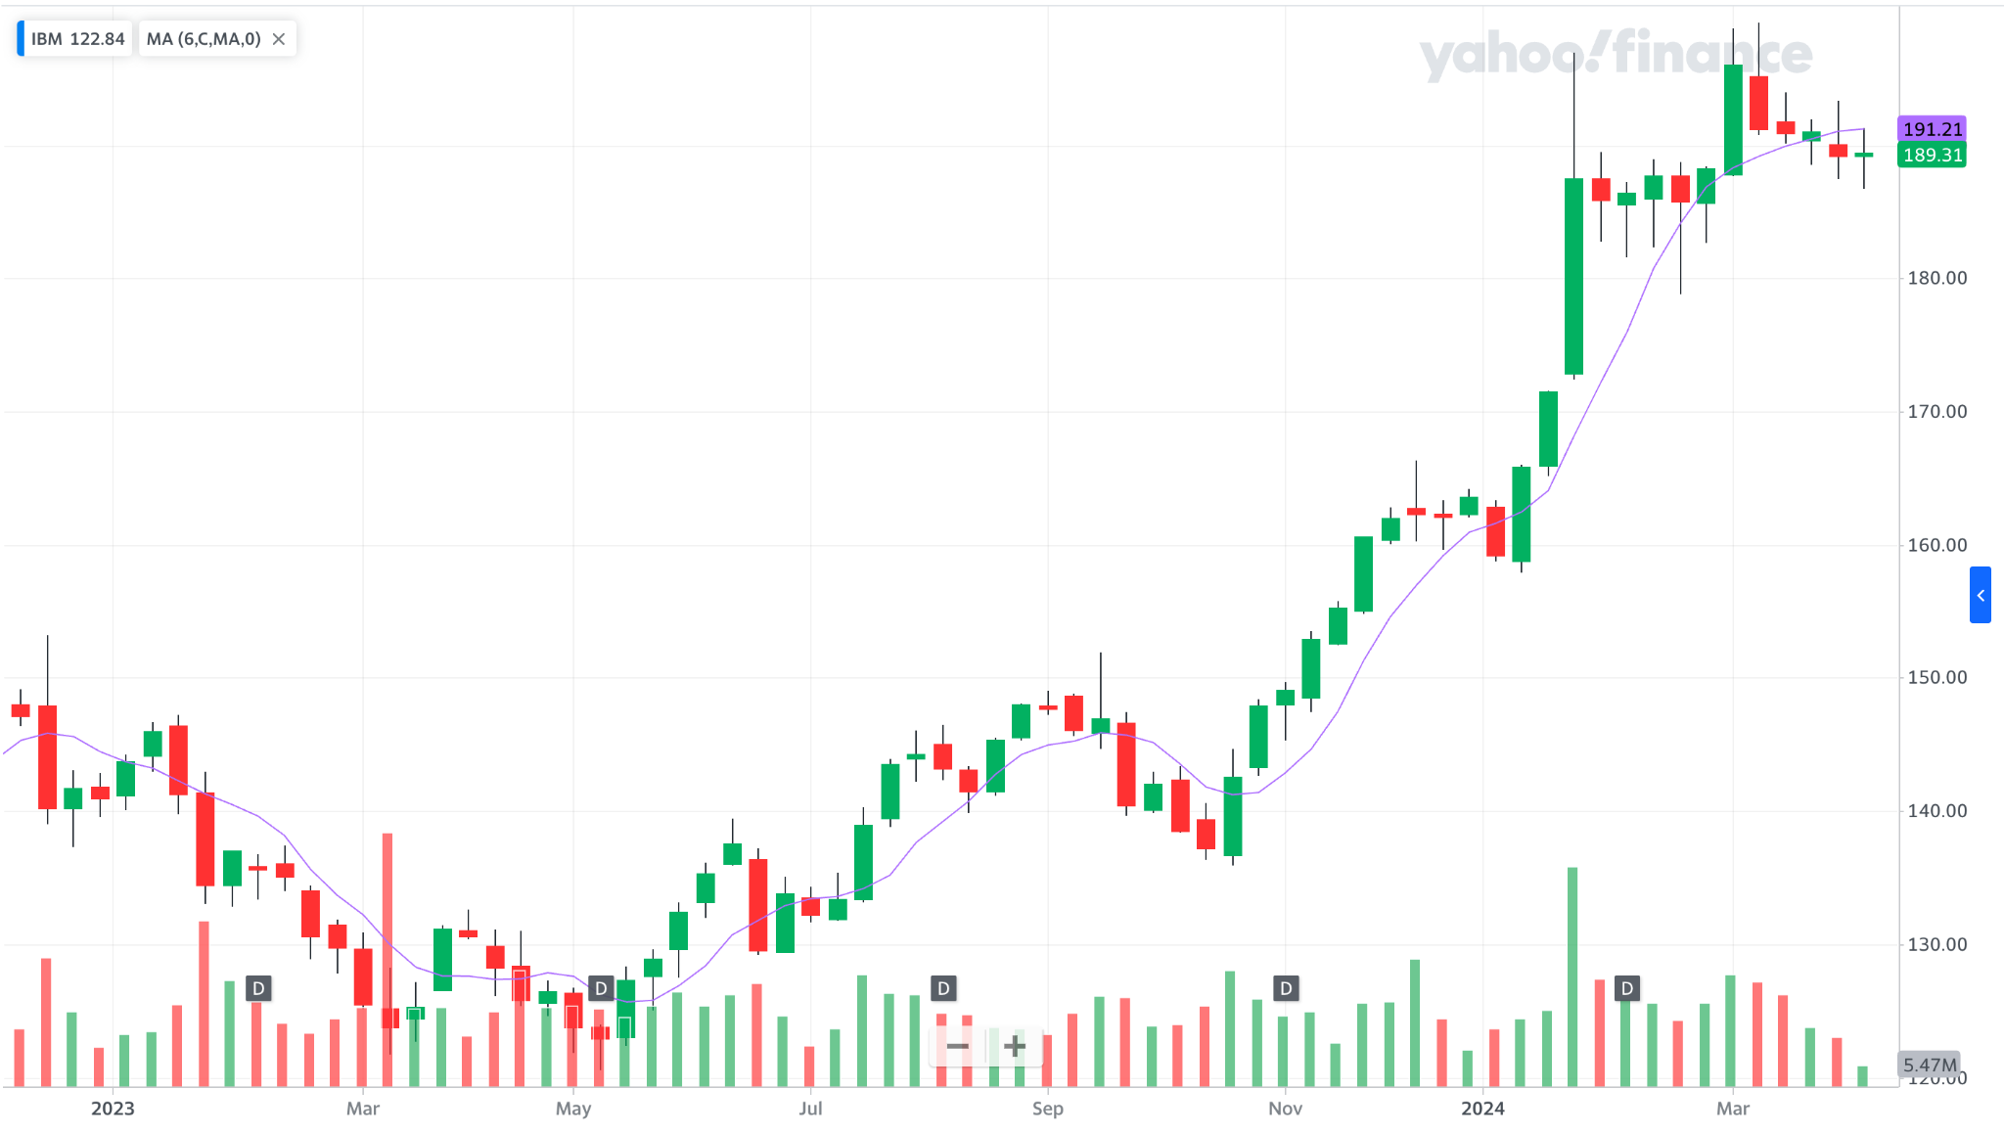
Technical Indicators
Goal: 225+ features per trading day
6-day Simple Moving Average (SMA)
6-20 day windows (+15 features)
Notes:
Eric

Slide 11
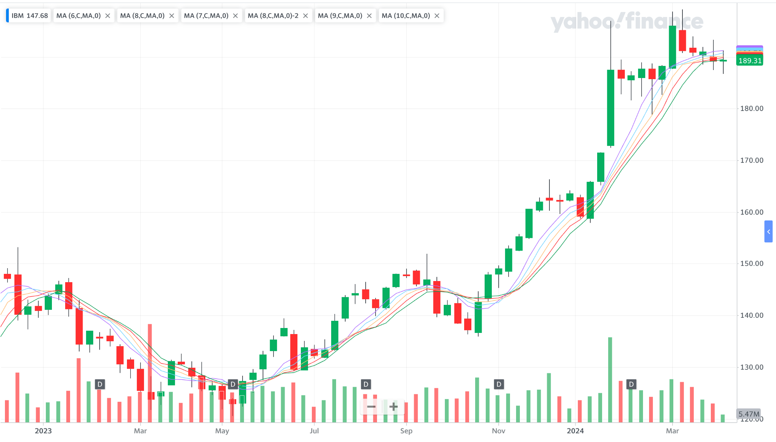
Technical Indicators
Notes:
Eric

Slide 12
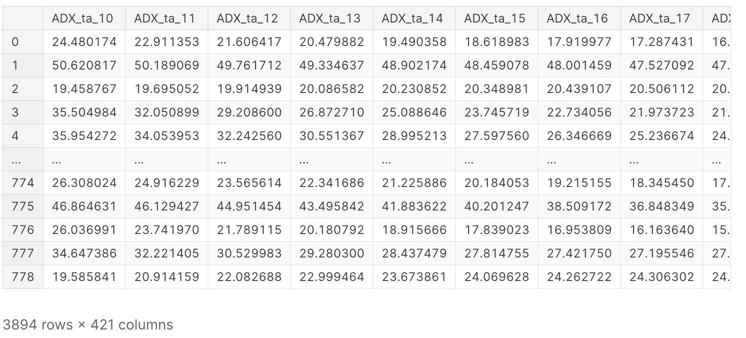
Technical Indicators
28 indicators * 15 sliding windows = 420 features
Notes:
Eric

Slide 13
4. Feature Selection

Slide 14
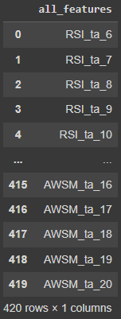
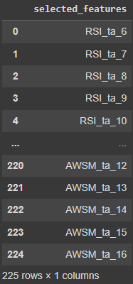
Selecting Top 225 Features
15 x 15 image = 225 features
Classification based feature selection
Notes:
Jubayer

Slide 15
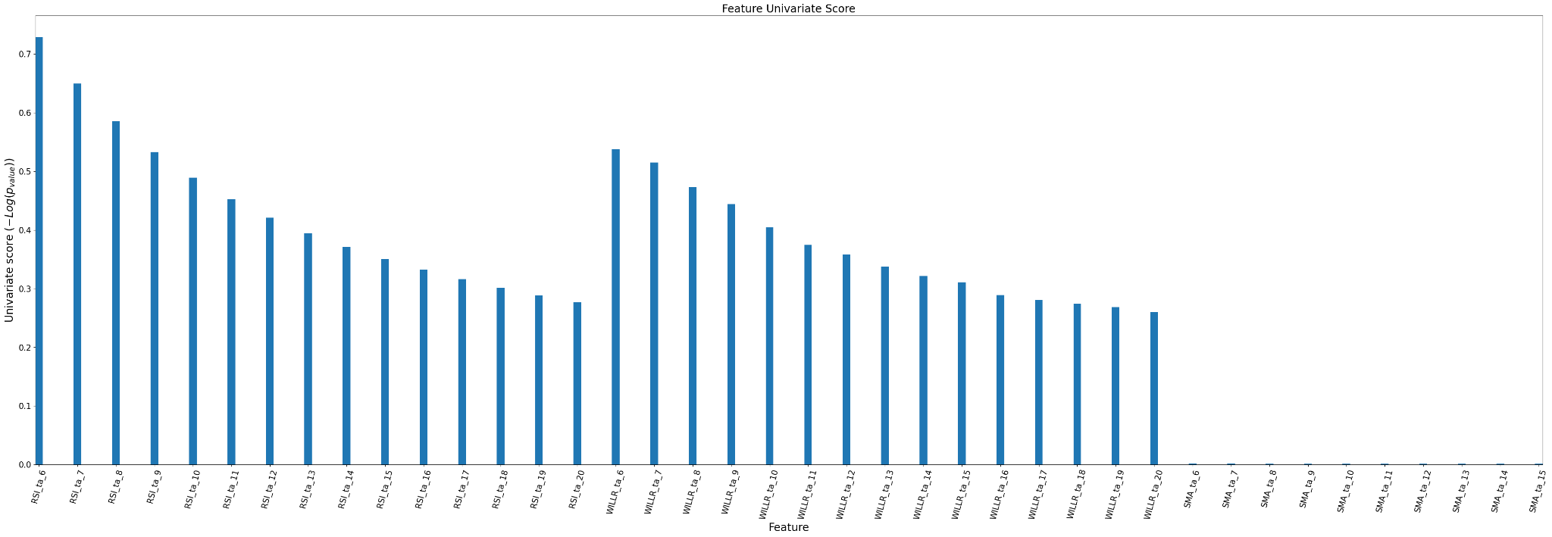
Univariate Feature Selection
High p-values indicate the feature contains no information about the prediction target
Notes:
Jubayer

Slide 16
5. Training & Evaluation

Slide 17
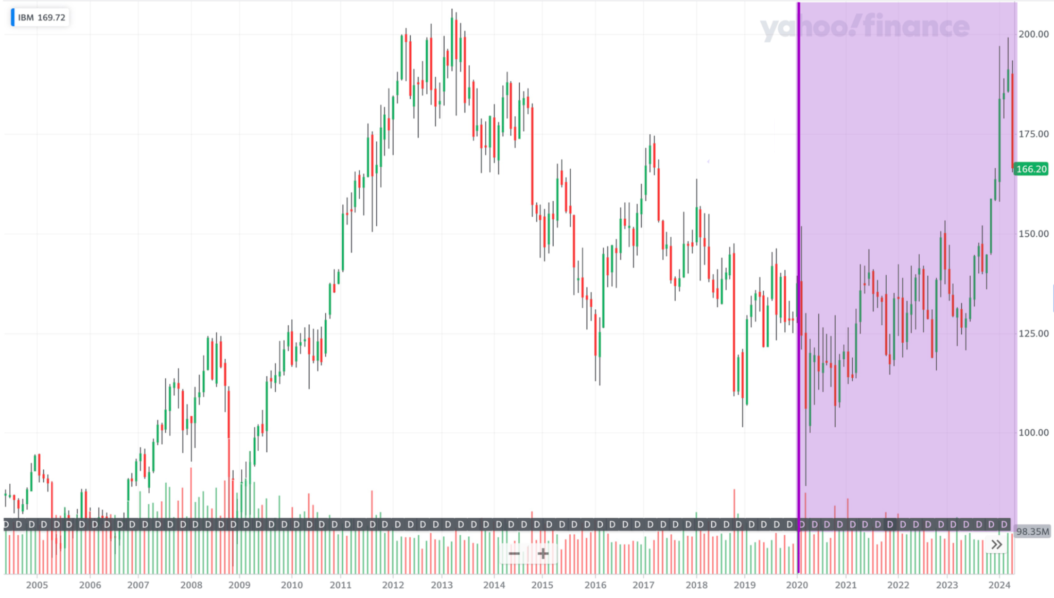
IBM Split Data
Backtesting
Model Data: 2004 - 2019
Train: 2180 samples
Validation: 935 samples
Test: 779 samples
Backtesting Data: 2020 - 2024
Notes:
Emmy
Total Model Data: 3894 Samples
Original Train and Test Split: 3115 train samples, 779 test samples
Actual Train and Validation Split: 2180 train samples, 935 samples

Slide 18
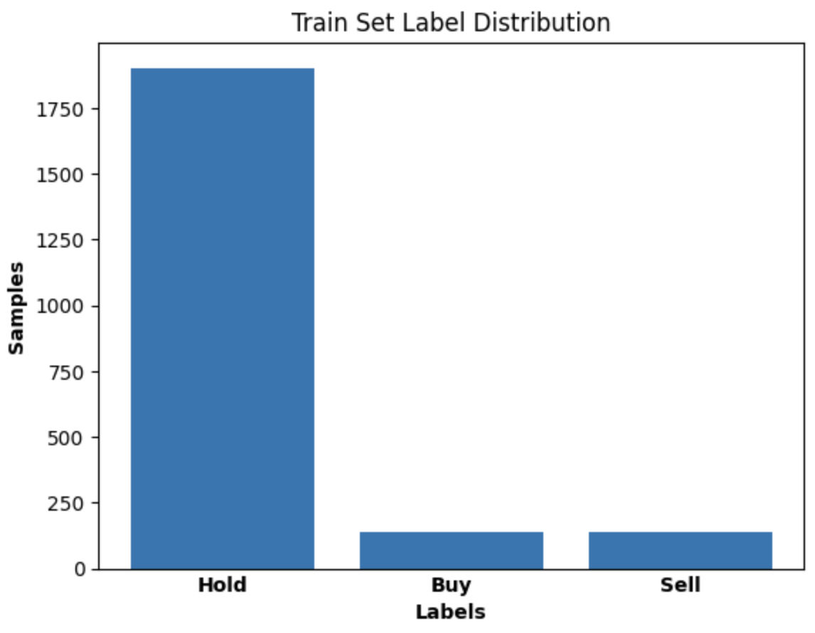
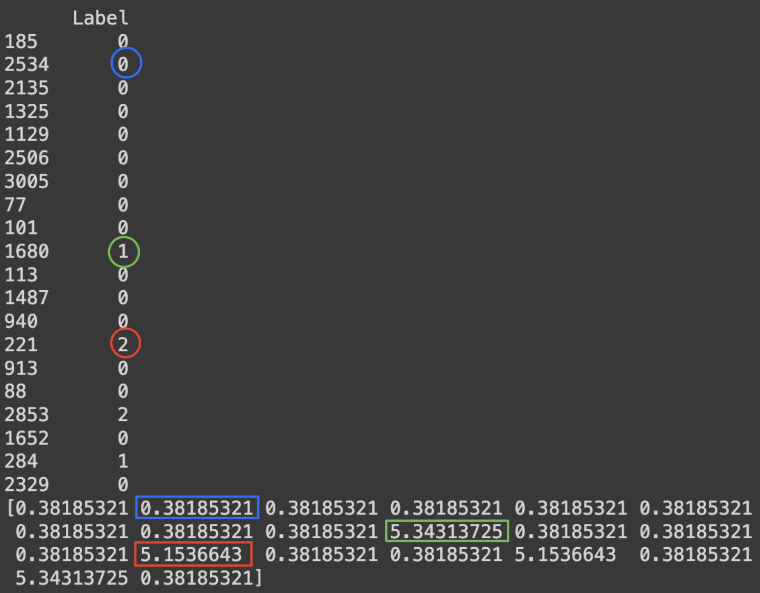
Imbalanced Classes
Sample Weights
Notes:
Emmy

Slide 19
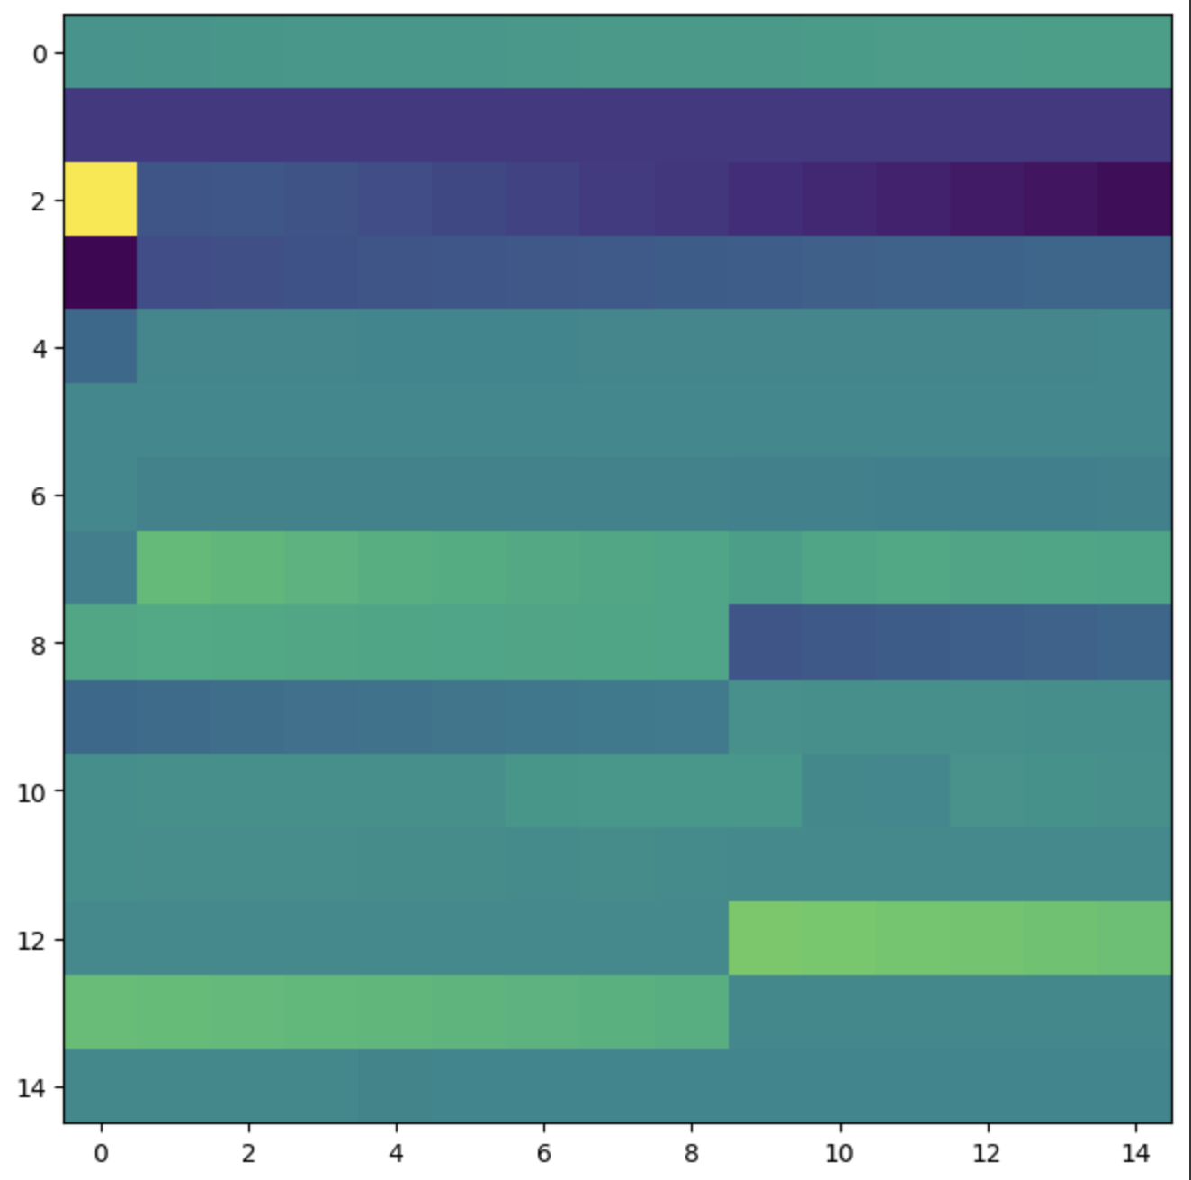
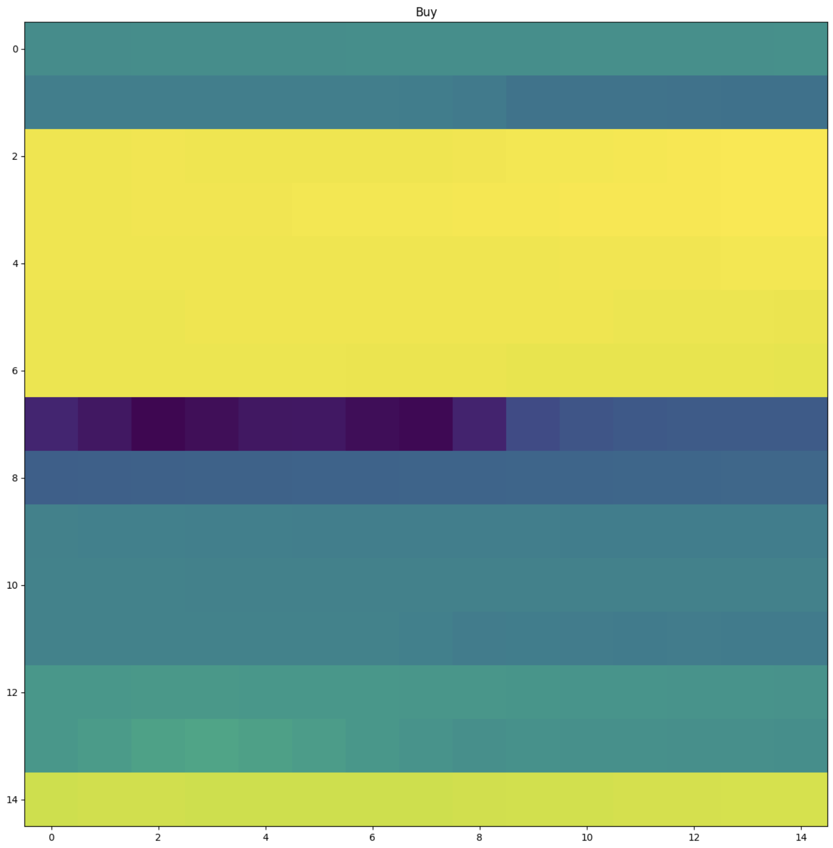
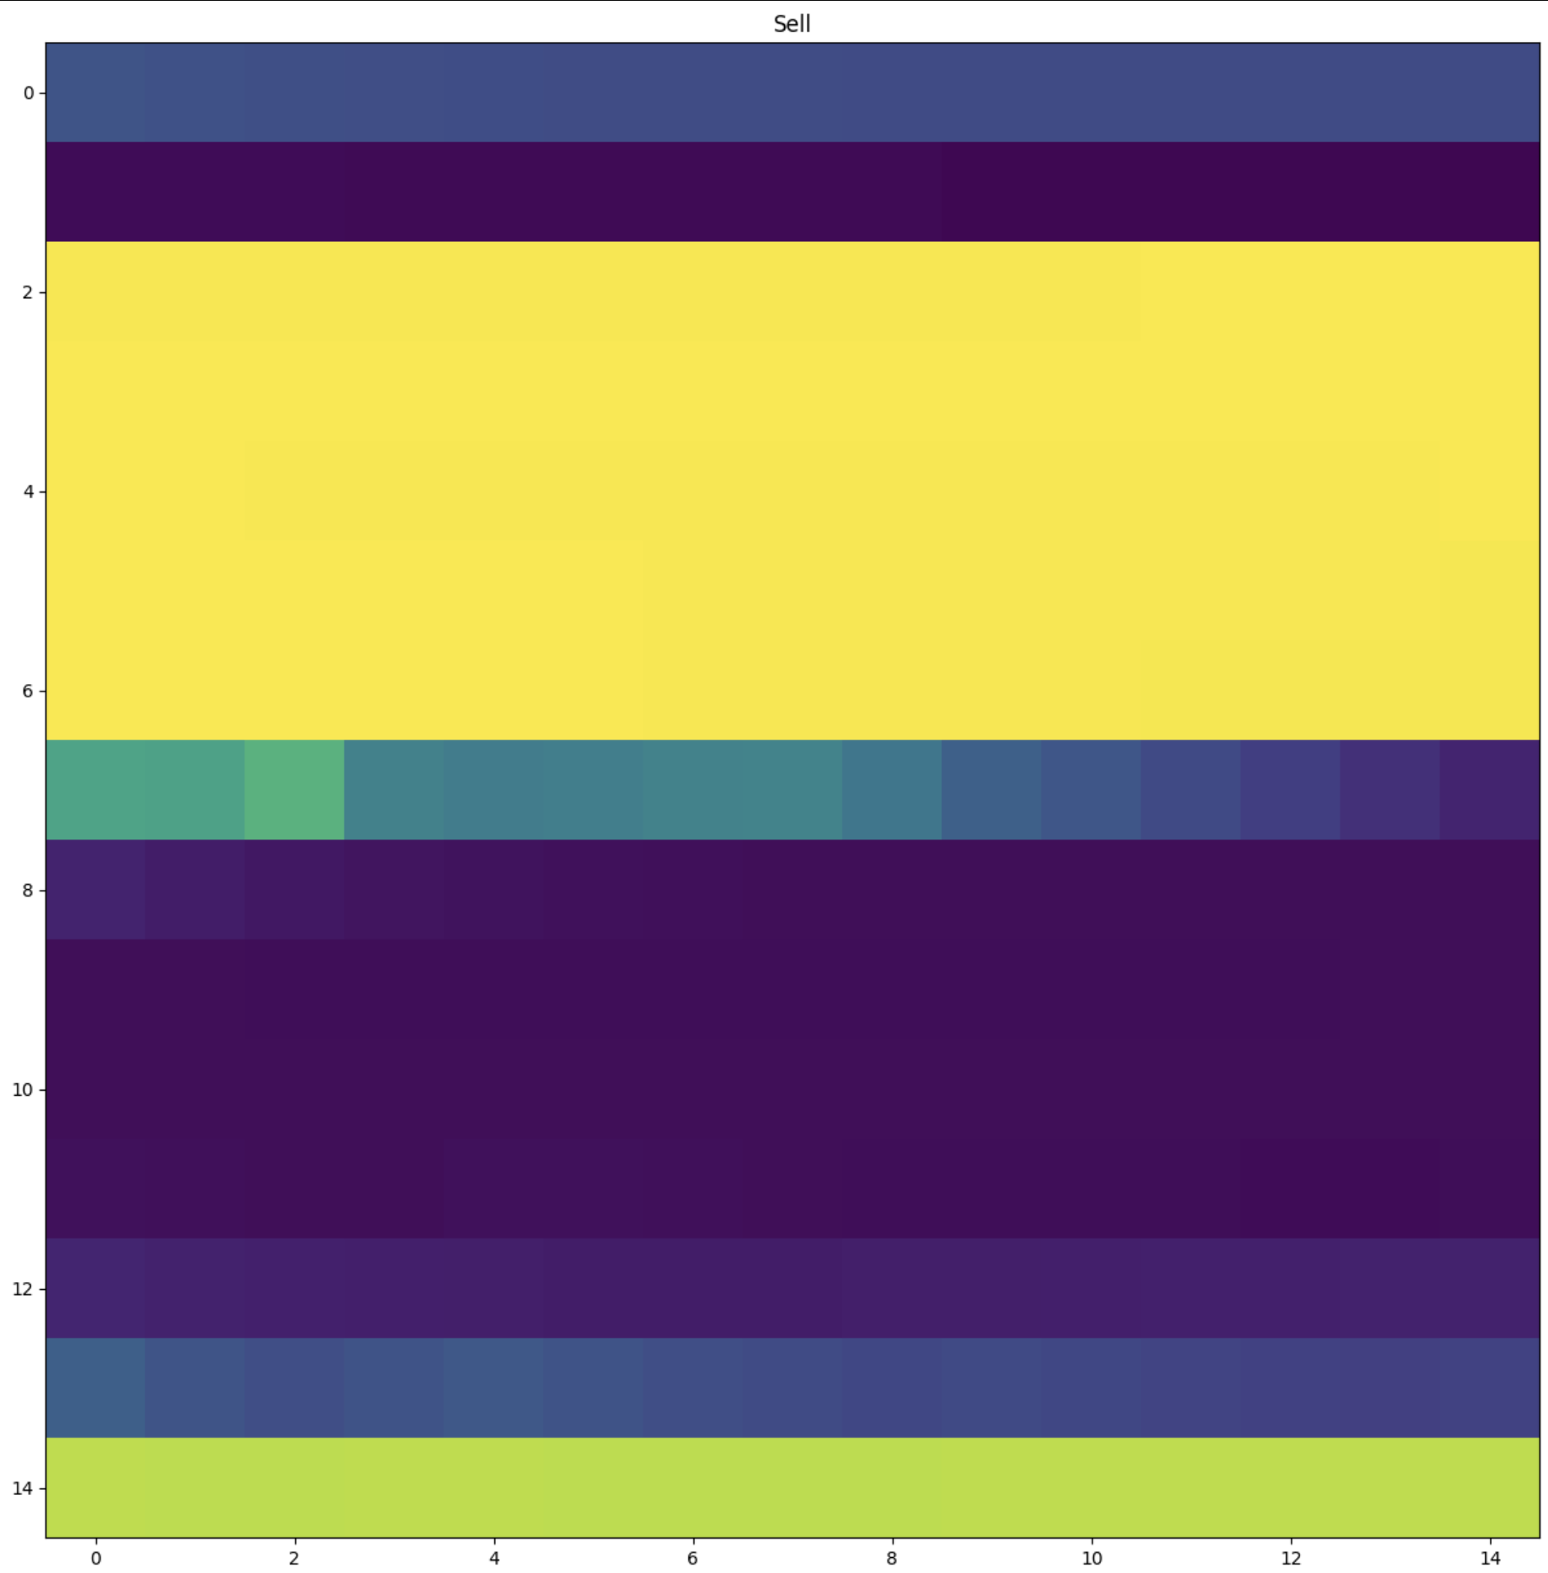
Reshape 225 Features Into 15 x 15 Images
Hold
Buy
Sell
Notes:
Jubayer/Emmy?

Slide 20
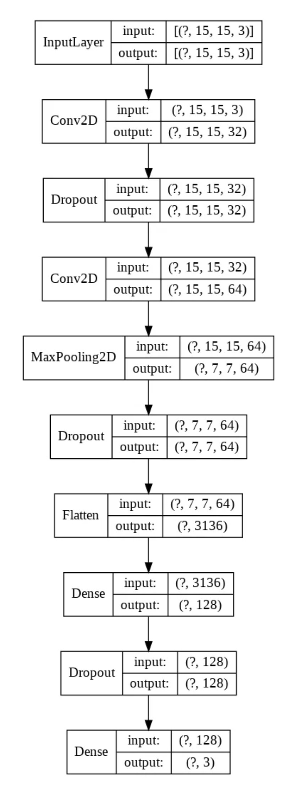
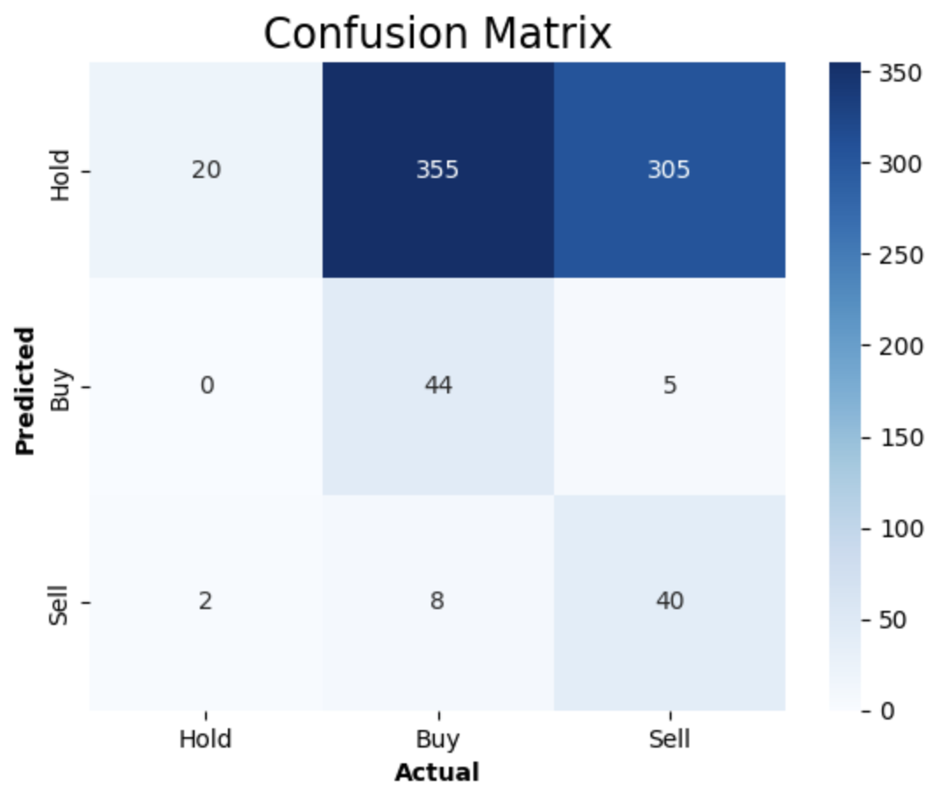
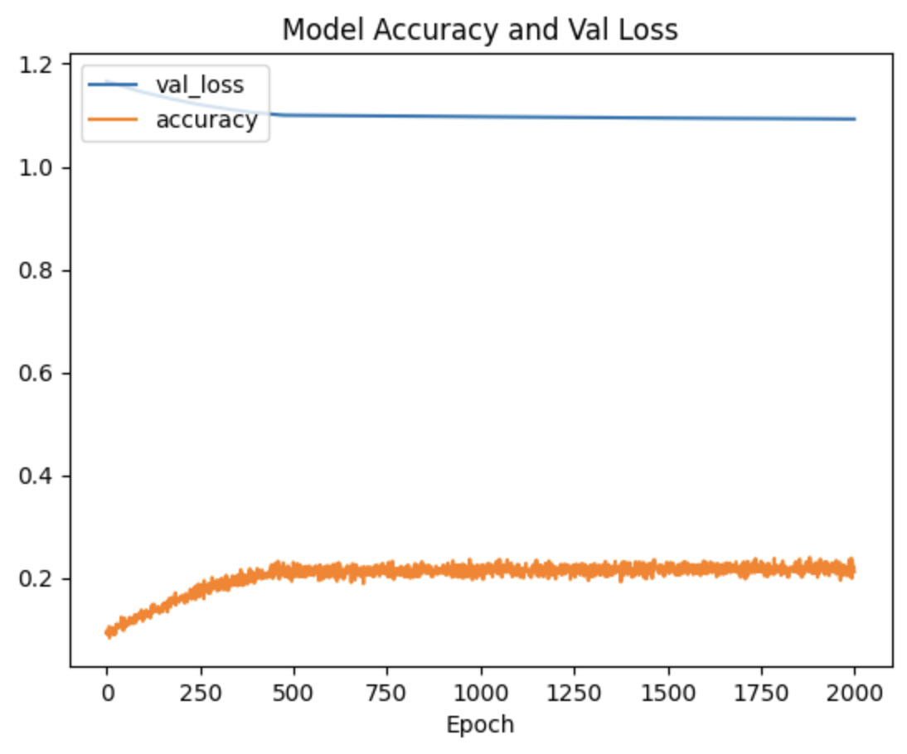
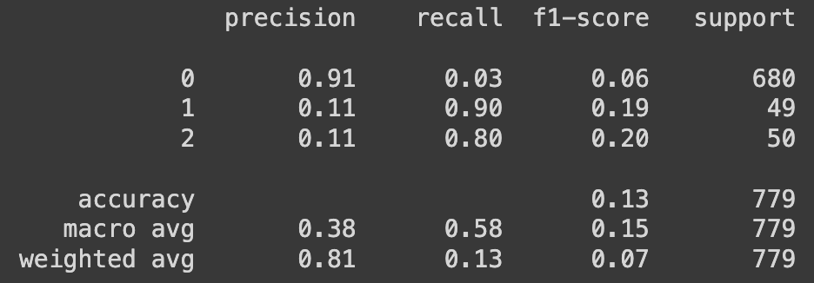
Original CNN-TA Model
Notes:
Eric

Slide 21
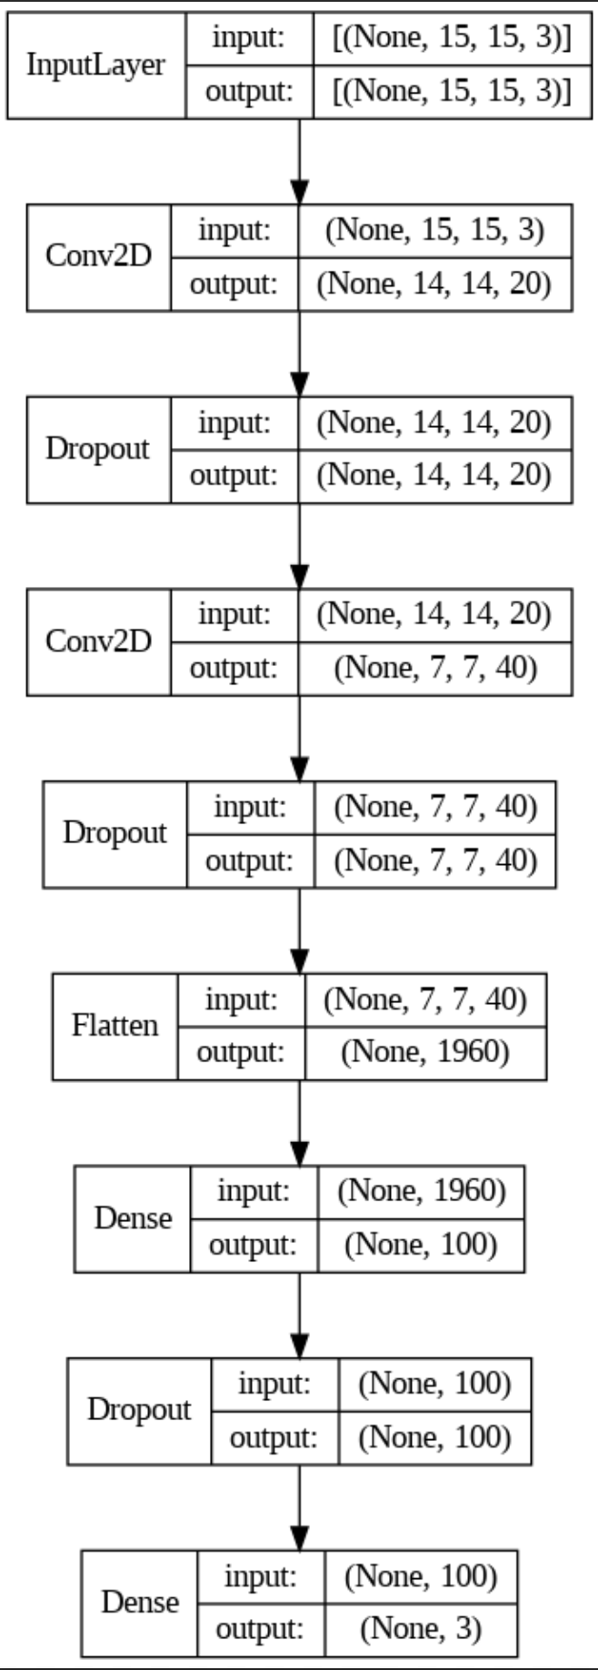
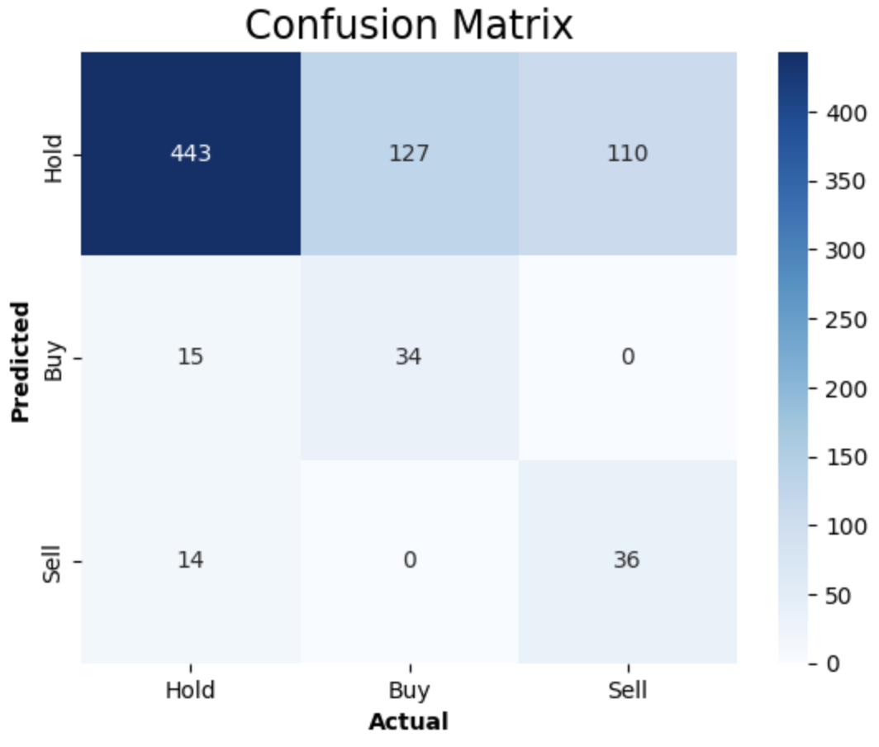
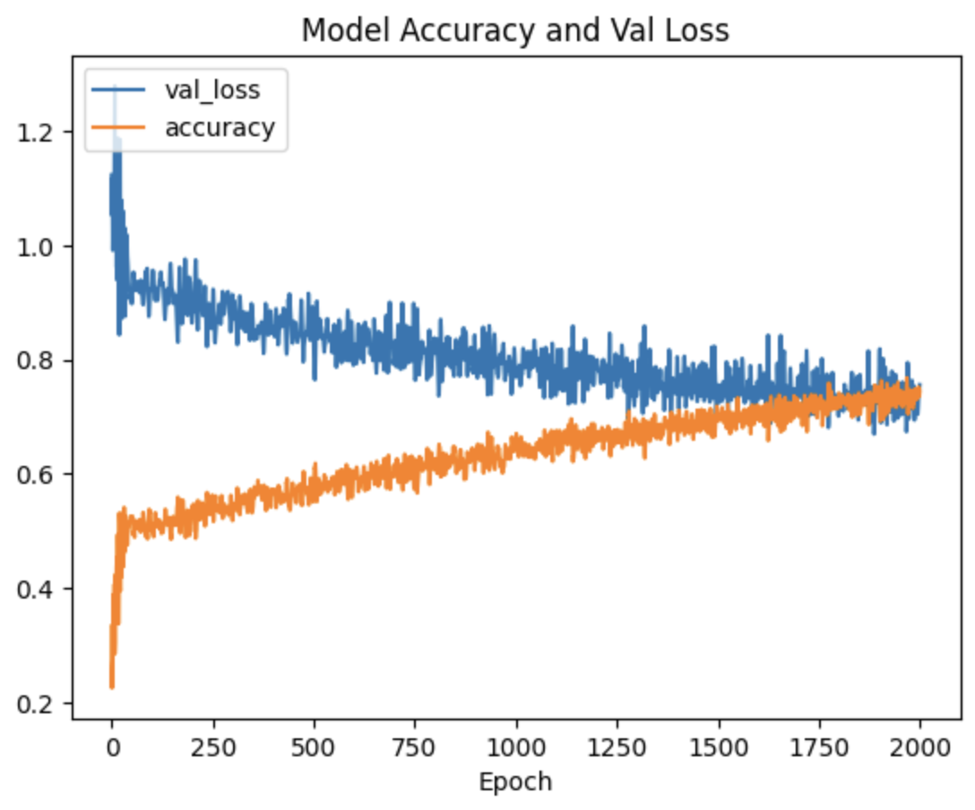
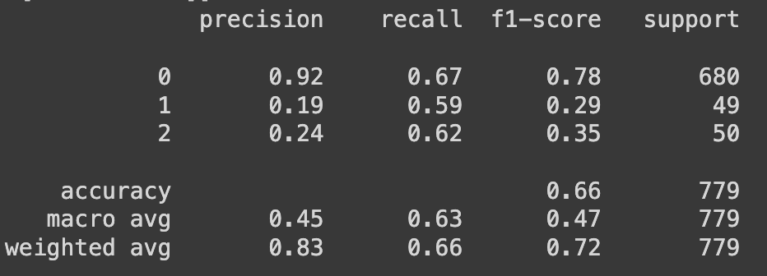
New CNN-TA Model
Notes:
Eric

Slide 22
6. Backtests

Slide 23
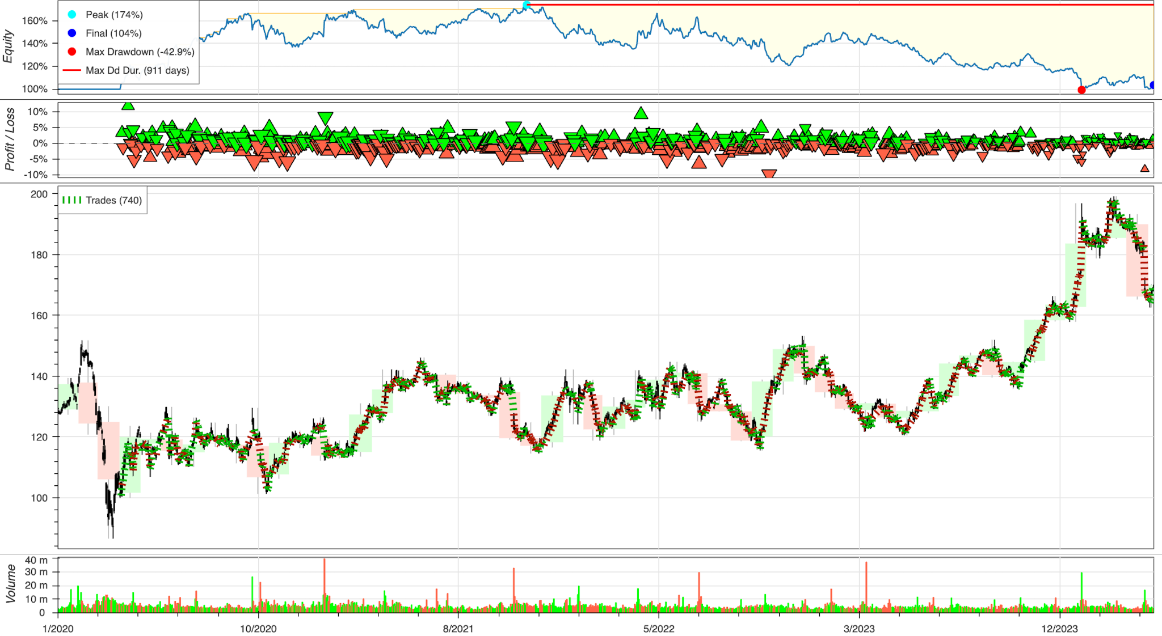
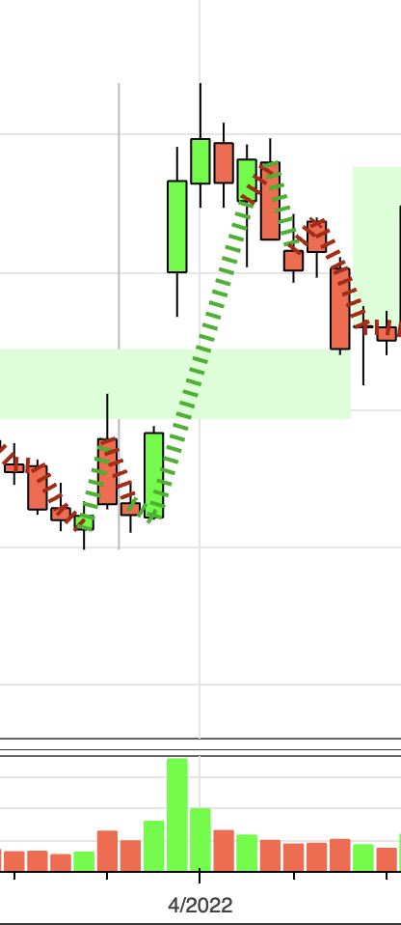
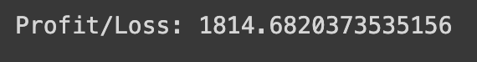
Backtesting
New CNN-TA plot on IBM
Notes:
Emmy

Slide 24
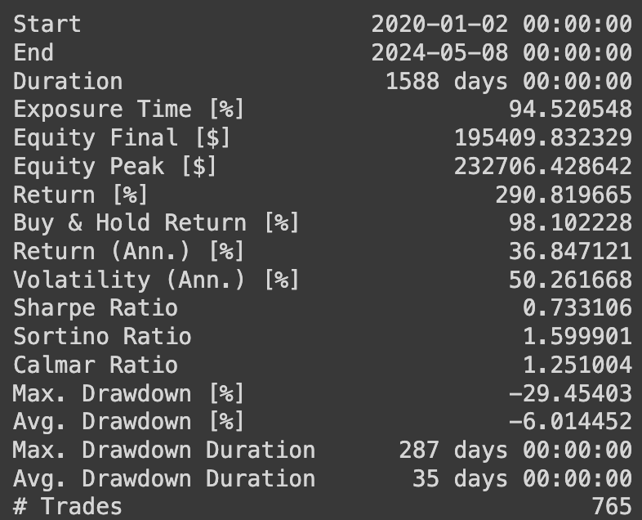
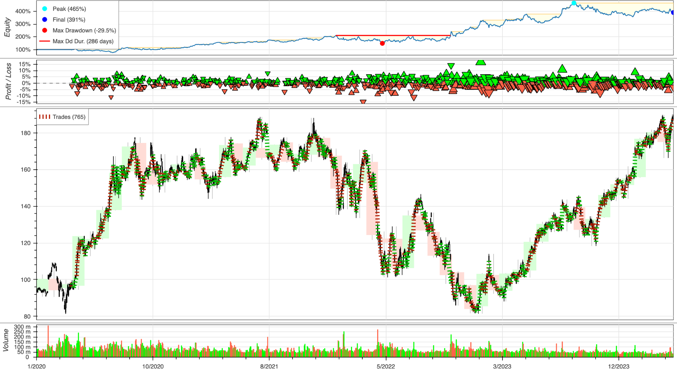
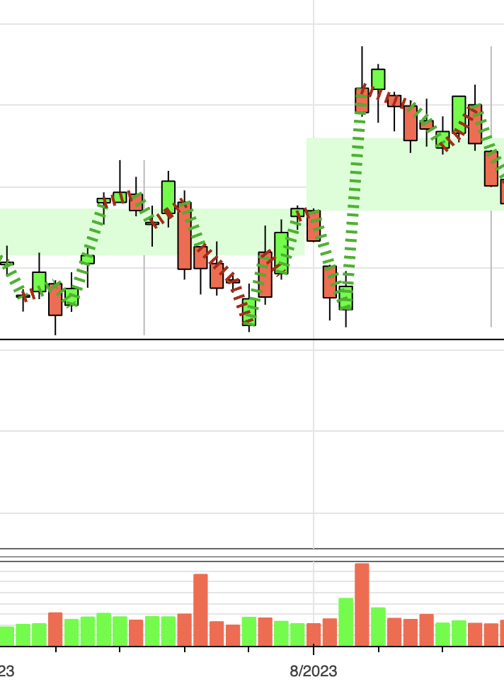
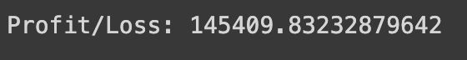
Backtesting
New CNN-TA plot on AMZN
Notes:
Emmy

Slide 25
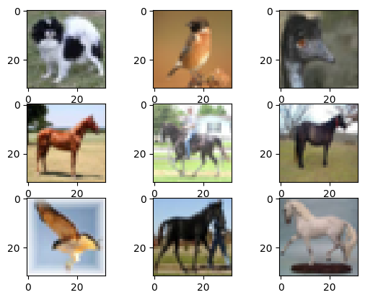
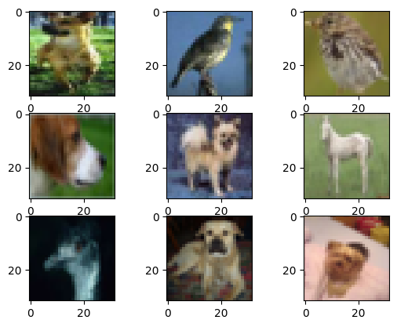
Image Classification on Animals
Image dataset with three classes (bird, dog, horse)
Notes:
Jubayer

Slide 26
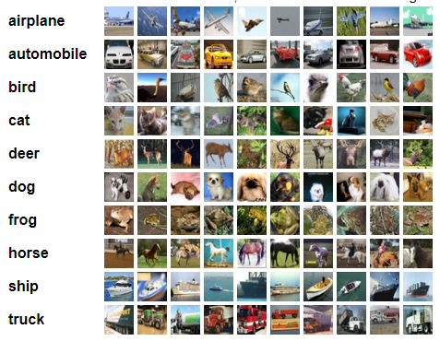
CIFAR10 Dataset Processing
CIFAR10 image set containing 10 classes of images
Notes:
Jubayer

Slide 27
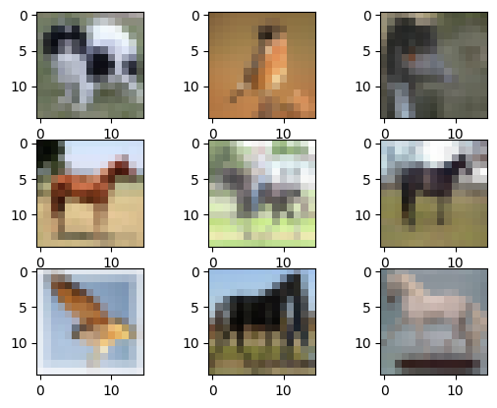
CIFAR10 Dataset Processing
Resize CIFAR10 images from 32x32 to 15x15
Notes:
Jubayer

Slide 28
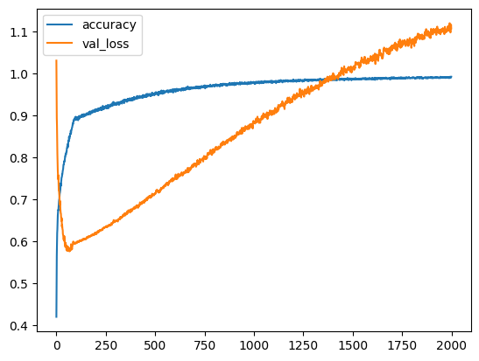
Trained CNN Performance
CNN trained on three classes of animals
Notes:
Jubayer

Slide 29
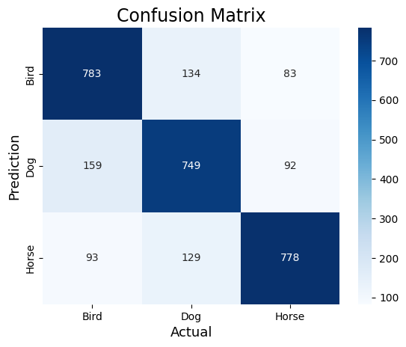
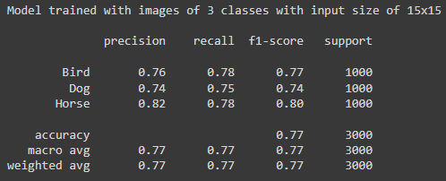
Trained CNN Performance
Notes:
Jubayer

Slide 30
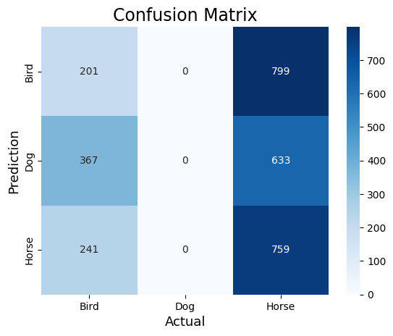
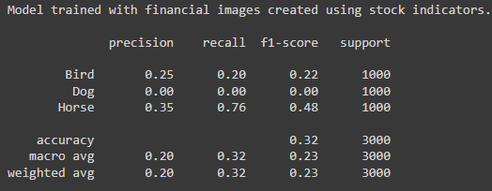
Financial CNN Performance
Notes:
Jubayer

Slide 31
CNN Classification
Notes:
Jubayer

Slide 32
Conclusion

